Slide 1

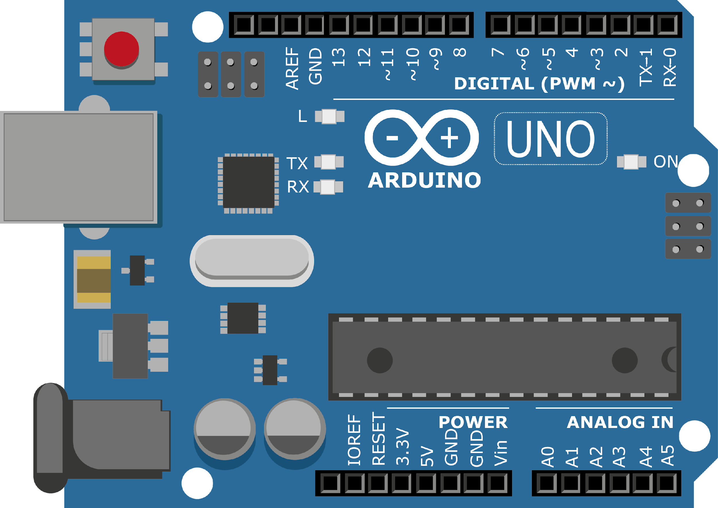
ARDUINO MASTER CLASS
11
DC Motor speed control

Slide 2
11 AGENDA
02
03
01
DC Motor speed control
PWM
Q & A

Slide 3
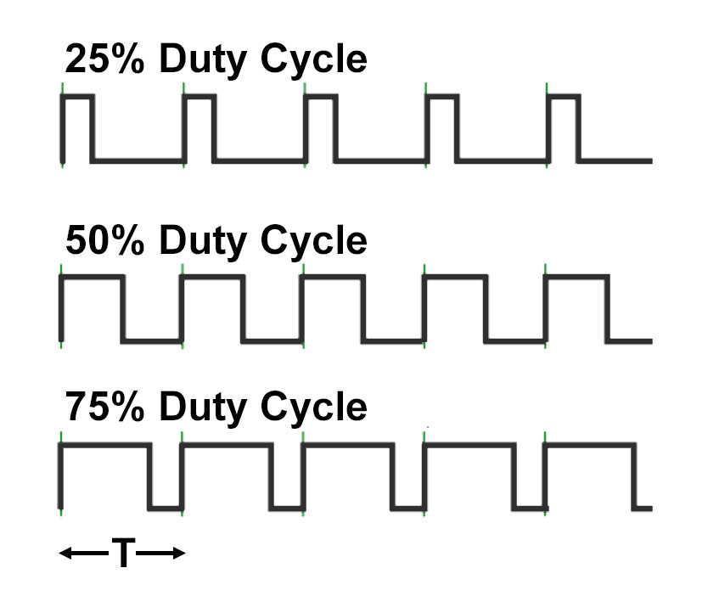
PWM – Pulse Width Modulation
Itis a method of reducing the average power delivered by an electrical signal, by effectively chopping it up into discrete parts.
It is a technique for getting analog results with digital means. Digital control is used to create a square wave, a signal switched between on and off.

Slide 4
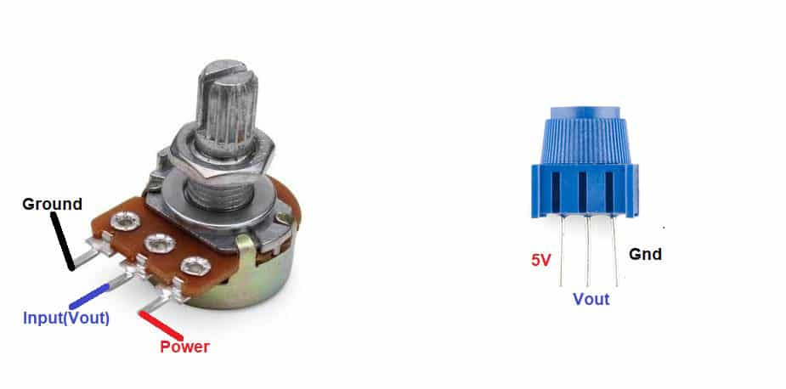
Potentiometer
A potentiometer is a three-terminal resistor with a sliding or rotating contact that forms an adjustable voltage divider. If only two terminals are used, one end and the wiper, it acts as a variable resistor or rheostat.

Slide 5
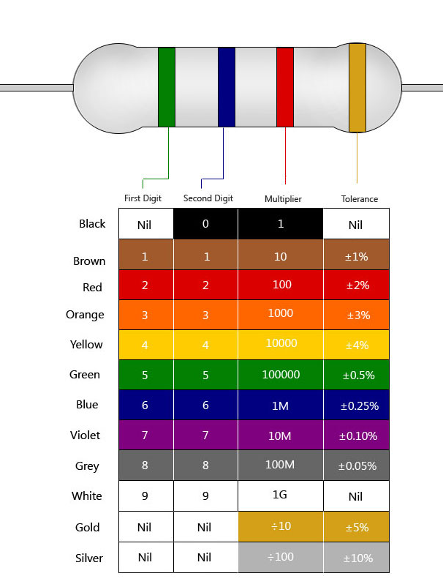
Resistor
A resistor is a passive two-terminal electrical component that implements electrical resistance as a circuit element. In electronic circuits, resistors are used to reduce current flow, adjust signal levels, to divide voltages, bias active elements, and terminate transmission lines, among other uses.

Slide 6
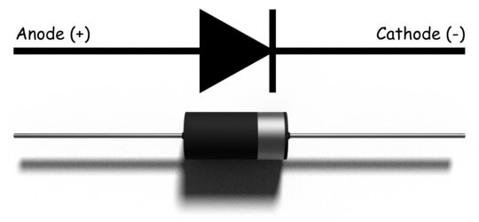
Diode
A diode is a semiconductor device that essentially acts as a one-way switch for current. It allows current to flow easily in one direction, but severely restricts current from flowing in the opposite direction.

Slide 7
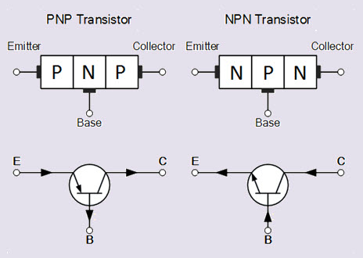
Transistor
A transistor is a semiconductor device used to amplify or switch electronic signals and electrical power. It is composed of semiconductor material usually with at least three terminals for connection to an external circuit.

Slide 8
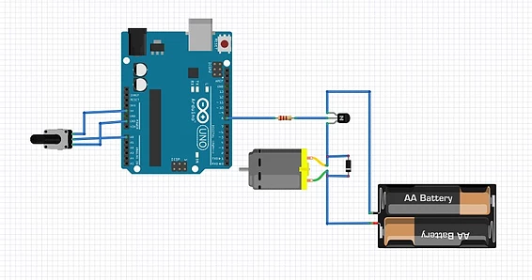
Circuit Diagram

Slide 9

INTERVIEW QUESTIONS
Purpose of Diode
Arduino's PWM frequency
Purpose of Transistor
A transistor is a semiconductor device used to amplify or switch electronic signals and electrical power
PNP transistors are used to source current, i.e. current flows out of the collector. PNP transistors are used as switches.
Diode is to allow an electric current to pass in one direction (called the diode's forward direction), while blocking it in the opposite direction (the reverse direction)
500Hz

Slide 10

THANKS!

